Slide 1
EEE 141.10 Project Presentation
FM LISTENING BUGGER
Name | ID
SADMAN ALAM | 1610544042
Page 1

Slide 2

Problem Statement:
- We know that bugger is a device which gives the information of a person, it is used for finding out the status of the person like where he/she is going, what he/she is talking etc.
-This is illegal but most of police or spy agencies use such bugger device. So here is the small circuit with which we can listen to another people conversation from long distance using the normal FM radio set.
-This FM bugger circuit is kept in room where we want to listen to the conversation. We can listen to this conversation using the normal FM radio set.
Page 2

Slide 3


Literature Review:
FM Bugger Circuit and Block Diagrams and Working. Electronics Hub. (2021). Retrieved 19 May 2021, from https://www.electronicshub.org/fm-bugger-circuit/.
Before you continue to YouTube. Youtu.be. (2021). Retrieved 19 May 2021, from https://youtu.be/1w2EBAIdtmE?list=PLzLZ6Ip7MV48qYBpT7XL_30K2eqBbUrNY.
Page 3

Slide 4


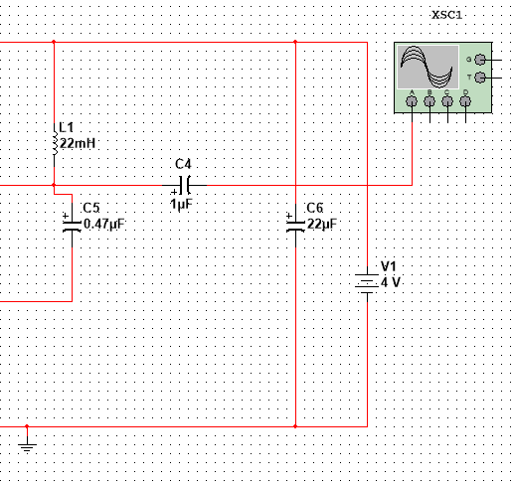
Impact and Application
The output message signal or modulating signal is modulated with the carrier frequency which is generated by the tank circuit.
The message signal and carrier signal is modulated by the transistor and transmit the modulated signal in the air through the antenna.
The modulated signal is received by the receiver antenna and gives to the FM radio where the user can listen to the conversation.
User should adjust the receiver frequency in the radio for receiving the signal from the transmitter.
Page 4

Slide 5

Challenges and problems
We will have to check whether the oscillator circuit is working properly or not before transmitting.
We can use a dipole antenna for transmitting the signal to increase the range of the transmitter.
Circuit operating voltage is around 4V, we can use a battery of 4V or normal DC supply as the power supply.
Page 5

Slide 6
Lists of hardware and software used
NI MULTISIM 12.0.1 for simulation.
No real hardware (all for simulation).
Page 6

Slide 7
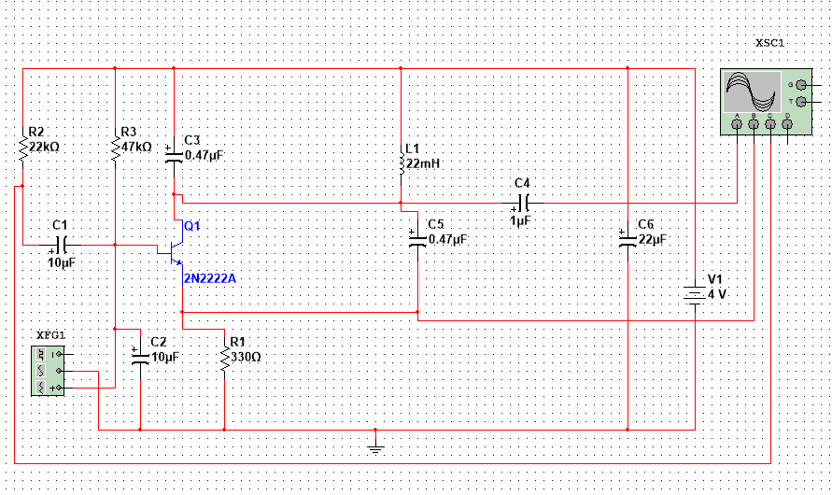
Circuit Diagram
Page 7

Slide 8
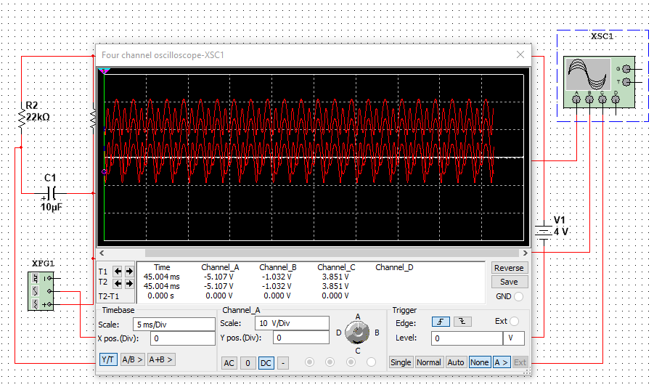
Results & Analysis
Page 8

Slide 9
Conclusion
This FM Listening Bugger circuit can be used in offices, colleges or anywhere we want.
But we will have to remember and keep that in mind where bugging is illegal.

